Slide 1
Lecture 9:
Distributed Database
Hemanga Gautam
hemanga.gautam@heraldcollege.edu.np

Slide 2
Concepts
Distributed Database.
  A logically interrelated collection of shared data (and a description of this data), physically distributed over a computer network.
Distributed DBMS.
  Software system that permits the management of the distributed database and makes the distribution transparent to users.
Notes:
September 98
3
Chapter Name

Slide 3
Collection of logically-related shared data.
Data split into fragments.
Fragments may be replicated.
Fragments/replicas allocated to sites.
Sites linked by a communications network.
Data at each site is under control of a DBMS.
DBMSs handle local applications autonomously.
Notes:
September 98
4
Chapter Name

Slide 4
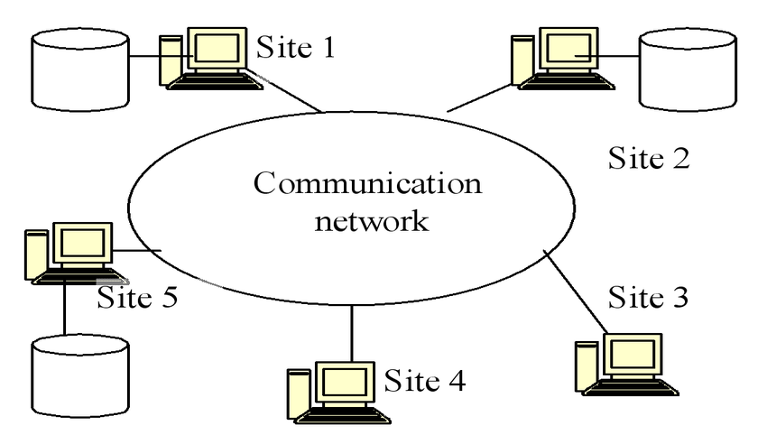
Component Architecture for a DDBMS

Slide 5
The Ideal Situation
A single application should be able to operate transparently on data that is:
  spread across a variety of different DBMS's
  running on a variety of different machines
  supported by a variety of different operating systems
  connected together by a variety of different communication networks
The distribution can be geographical or local

Slide 6
Workable definition
A distributed database system consists of a collection of sites connected together via some kind of communications network, in which :
  Each site is a database system site in its own right;
  All the sites agree to work together, so that a user at any site can access data anywhere in the network exactly as if the data were all stored at the user's own site
It is a logical union of real databases

Slide 7
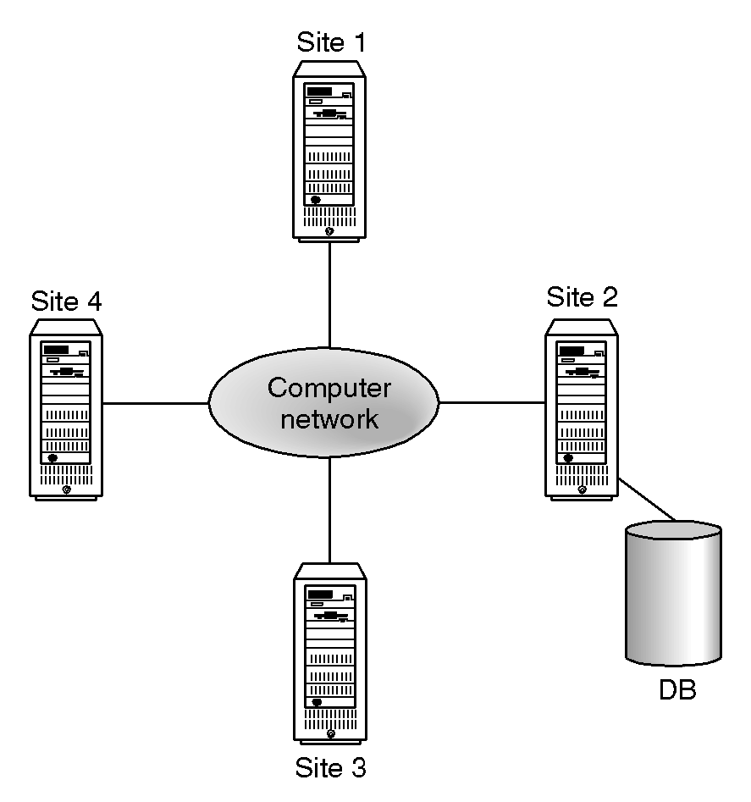
Distributed Processing
A centralized database that can be accessed over a computer network.
6
Notes:
September 98
6
Chapter Name

Slide 8
Advantages of DDBMSs
Organizational Structure
Sharable and Local Autonomy
Improved Availability
Improved Reliability
Economics
Modular Growth
Improved performance
Notes:
September 98
10
Chapter Name

Slide 9
Disadvantages of DDBMSs
Cost
Security
Integrity Control More Difficult
Lack of Experience
Database Design More Complex
Notes:
September 98
11
Chapter Name

Slide 10
Types of DDBMS
Homogeneous DDBMS
Heterogeneous DDBMS
Notes:
September 98
12
Chapter Name

Slide 11
Homogeneous DDBMS
All sites use same DBMS product. (same software)
Much easier to design and manage.
Approach provides incremental growth and allows increased performance.
Notes:
September 98
13
Chapter Name

Slide 12
Heterogeneous DDBMS
Occurs when sites have implemented their own databases and integration is considered later.
  Different hardware. (or OS)
  Different DBMS products/softwares.
  Different hardware and different DBMS products.
Typical solution is to use gateways.
Query processing is complex due to dissimilar schemas.
Notes:
September 98
14
Chapter Name

Slide 13
Open Database Access and Interoperability
Common SQL API that allows client applications to be written that do not need to know vendor of DBMS they are accessing.
  Common database protocol that enables DBMS from one vendor to communicate directly with DBMS from another.
  Common network protocol that allows communications between different DBMSs.
Goal is to find a way to enable transaction to span DBMSs from different vendors without use of a gateway.
Notes:
September 98
15
Chapter Name

Slide 14
Functions of a DDBMS
Expect DDBMS to have at least the functionality of a DBMS.
Also to have following functionality:
  Extended Data Dictionary.
  Distributed query processing.
  Extended concurrency control.
  Extended recovery services.
Notes:
September 98
20
Chapter Name

Slide 15
Distributed Database Design
Three key issues/processes to deal with when using DDBMS:
  Fragmentation.
  Allocation
  Replication
Notes:
September 98
26
Chapter Name

Slide 16
Distributed Database Design
Fragmentation
  Relation may be divided into a number of sub-relations, which are then distributed.
Allocation
  Each fragment is stored at site with "optimal" distribution.
Replication
  Copy of fragment may be maintained at several sites.
Notes:
September 98
27
Chapter Name

Slide 17
Fragmentation
Definition and allocation of fragments carried out strategically to achieve:
  Improved Availability
  Improved Performance
  Balanced Storage Capacities and Costs
  Minimal Communication Costs.
Involves analyzing most important applications, based on quantitative/qualitative information.
Notes:
September 98
28
Chapter Name

Slide 18
Fragmentation
Quantitative information may include:
  frequency with which an application is run;
  site from which an application is run
Qualitative information may include
type of access (read or write),
Notes:
September 98
29
Chapter Name

Slide 19
Data Allocation
Four alternative strategies regarding placement of data:
  Centralized
  Partitioned (or Fragmented)
  Complete Replication
  Selective Replication
Notes:
September 98
30
Chapter Name

Slide 20
Data Allocation
Centralized
  Consists of single database and DBMS stored at one site with users distributed across the network.
Partitioned
  Database partitioned into disjoint fragments, each fragment assigned to one site.
Notes:
September 98
31
Chapter Name

Slide 21
Data Allocation
Complete Replication
  Consists of maintaining complete copy of database at each site.
Selective Replication
  Combination of partitioning, replication, and centralization.
Notes:
September 98
32
Chapter Name

Slide 22
Why Fragment?
Usage
  Applications work with views rather than entire relations.
Efficiency
  Data is stored close to where it is most frequently used.
  Data that is not needed by local applications is not stored.
Notes:
September 98
34
Chapter Name

Slide 23
Why Fragment?
Parallelism
  With fragments as unit of distribution, transaction can be divided into several subqueries that operate on fragments.
Security
  Data not required by local applications is not stored and so not available to unauthorized users.
Disadvantages
  Performance
  Integrity.
Notes:
September 98
35
Chapter Name

Slide 24
Correctness of Fragmentation
Three correctness rules:
  Completeness
  Reconstruction
  Disjointness.
Notes:
September 98
37
Chapter Name

Slide 25
Correctness of Fragmentation
Completeness
  If relation R is decomposed into fragments R1, R2, ... Rn, each data item that can be found in R must appear in at least one fragment.
Reconstruction
  Must be possible to define a relational operation that will reconstruct R from the fragments.
  Reconstruction for horizontal fragmentation is Union operation and Join for vertical .
Notes:
September 98
38
Chapter Name

Slide 26
Correctness of Fragmentation
Disjointness
  If data item di appears in fragment Ri, then it should not appear in any other fragment.
  Exception: vertical fragmentation, where primary key attributes must be repeated to allow reconstruction.
  For horizontal fragmentation, data item is a tuple
  For vertical fragmentation, data item is an attribute.
Notes:
September 98
39
Chapter Name

Slide 27
Types of Fragmentation
Three types of fragmentation:
  Horizontal
  Vertical
  Mixed
Other possibility is no fragmentation:
  If relation is small and not updated frequently, may be better not to fragment relation.
Notes:
September 98
40
Chapter Name

Slide 28
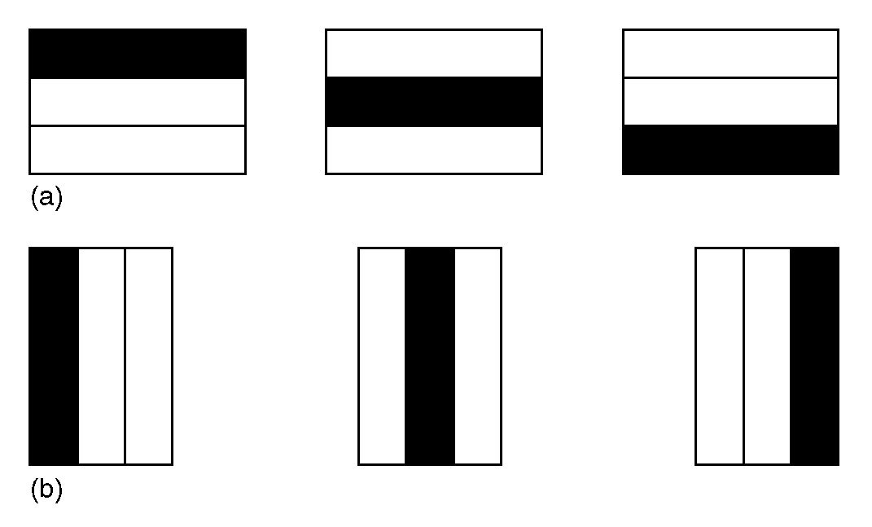
Horizontal and Vertical Fragmentation
41
Notes:
September 98
41
Chapter Name

Slide 29
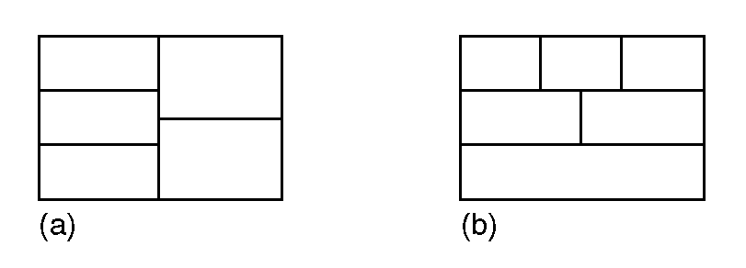
Mixed Fragmentation
Notes:
September 98
42
Chapter Name

Slide 30
Transparencies in a DDBMS
  Fragmentation Transparency
  Location Transparency
  Replication Transparency
  Naming Transparency
  Transaction Transparency
    Concurrency Transparency
    Failure Transparency
  Performance Transparency
  DBMS Transparency
Notes:
September 98
51
Chapter Name

Slide 31
Distribution Transparency
Distribution transparency allows user to perceive database as single, logical entity.
If DDBMS exhibits distribution transparency, user does not need to know:
  data is fragmented (fragmentation transparency),
  location of data items (location transparency),
Notes:
September 98
53
Chapter Name

Slide 32
Naming Transparency
Each item in a DDB must have a unique name.
DDBMS must ensure that no two sites create a database object with same name.
One solution is to create central name server. However, this results in:
  loss of some local autonomy;
  central site may become a bottleneck;
  low availability; if the central site fails, remaining sites cannot create any new objects.
Notes:
September 98
54
Chapter Name

Slide 33
Transaction Transparency
Ensures that all distributed transactions maintain distributed database’s integrity and consistency.
Distributed transaction accesses data stored at more than one location.
Each transaction is divided into number of sub-transactions, one for each site that has to be accessed.
DDBMS must ensure the indivisibility of both the global transaction and each sub transactions.
Notes:
September 98
57
Chapter Name

Slide 34
Concurrency Transparency
All transactions must execute independently and be logically consistent with results obtained if transactions executed one at a time, in some arbitrary serial order.
Same fundamental principles as for centralized DBMS.
DDBMS must ensure both global and local transactions do not interfere with each other.
Notes:
September 98
59
Chapter Name

Slide 35
Performance Transparency
DDBMS must perform as if it were a centralized DBMS.
  DDBMS should not suffer any performance degradation due to distributed architecture.
  DDBMS should determine most cost-effective strategy to execute a request.
Notes:
September 98
63
Chapter Name

Slide 36
Concurrency Transparency
Replication makes concurrency more complex.
If a copy of a replicated data item is updated, update must be propagated to all copies.
Could propagate changes as part of original transaction, making it an atomic operation.
However, if one site holding copy is not reachable, then transaction is delayed until site is reachable.
Notes:
September 98
60
Chapter Name

Slide 37
Concurrency Transparency
Could limit update propagation to only those sites currently available. Remaining sites updated when they become available again.
Could allow updates to copies to happen asynchronously, sometime after the original update. Delay in regaining consistency may range from a few seconds to several hours.
Notes:
September 98
61
Chapter Name

Slide 38
Failure Transparency
DDBMS must ensure atomicity and durability of global transaction.
Means ensuring that sub-transactions of global transaction either all commit or all abort.
Thus, DDBMS must synchronize global transaction to ensure that all sub-transactions have completed successfully before recording a final COMMIT for global transaction.
Must do this in presence of site and network failures.
Notes:
September 98
62
Chapter Name

Slide 39
Performance Transparency
Distributed Query Processor (DQP) maps data request into ordered sequence of operations on local databases.
Must consider fragmentation, replication, and allocation schemas.
DQP has to decide:
  which fragment to access;
  which copy of a fragment to use;
  which location to use.
Notes:
September 98
64
Chapter Name

Slide 40
Performance Transparency
DQP produces execution strategy optimized with respect to some cost function.
Typically, costs associated with a distributed request include:
  I/O cost;
  CPU cost;
  communication cost.
Notes:
September 98
65
Chapter Name

Slide 41
Scaling Traditional Databases
Traditional RDBMSs can be either scaled:
  Vertically (or Up)
    Can be achieved by hardware upgrades (e.g., faster CPU, more memory, or larger disk)
    Limited by the amount of CPU, RAM and disk that can be configured on a single machine
  Horizontally (or Out)
    Can be achieved by adding more machines
    Requires database sharding and probably replication
    Limited by the Read-to-Write ratio and communication overhead

Slide 42
Why Sharding Data?
Data is typically sharded (or striped) to allow for concurrent/parallel accesses
Input data: A large file
Machine 1
Machine 2
Machine 3
Chunk1 of input data
Chunk3 of input data
Chunk5 of input data
Chunk2 of input data
Chunk4 of input data
Chunk6 of input data
E.g., Chunks 1, 3 and 5 can be accessed in parallel

Slide 43

Why Replicating Data?
Replicating data across servers helps in:
  Avoiding performance bottlenecks
  Avoiding single point of failures
  And, hence, enhancing scalability and availability
Main Server
Replicated Servers

Slide 44
But, Consistency Becomes a Challenge
An example:
  In an e-commerce application, the bank database has been replicated across two servers
  Maintaining consistency of replicated data is a challenge
Event 1 = Add $1000
Event 2 = Add interest of 5%
1
2
Bal=2000
4
Bal=2100
Bal=1000
3
Bal=1000
Bal=1050
Bal=2050
Replicated Database

Slide 45
The CAP Theorem
The limitations of distributed databases can be described in the so called the CAP theorem
  Consistency: every node always sees the same data at any given instance (i.e., strict consistency)
  Availability: the system continues to operate, even if nodes in a cluster crash, or some hardware or software parts are down due to upgrades
  Partition Tolerance: the system continues to operate in the presence of network partitions
CAP theorem: any distributed database with shared data, can have at most two of the three desirable properties, C, A or P

Slide 46

The CAP Theorem (Cont’d)
Let us assume two nodes on opposite sides of a
network partition:
Availability + Partition Tolerance forfeit Consistency
Consistency + Partition Tolerance entails that one side of the partition must act as if it is unavailable, thus
forfeiting Availability
Consistency + Availability is only possible if there is no network partition, thereby forfeiting Partition Tolerance

Slide 47
Large-Scale Databases
When companies such as Google and Amazon were designing large-scale databases, 24/7 Availability was a key
  A few minutes of downtime means lost revenue
When horizontally scaling databases to 1000s of machines, the likelihood of a node or a network failure
increases tremendously
Therefore, in order to have strong guarantees on Availability and Partition Tolerance, they had to sacrifice “strict” Consistency (implied by the CAP theorem)

Slide 48

Trading-Off Consistency
Maintaining consistency should balance between the strictness of consistency versus availability/scalability
  Good-enough consistency depends on your application
Loose Consistency
Strict Consistency
Easier to implement, and is efficient
  Generally hard to implement, and is inefficient

Slide 49
Eventual Consistency
A database is termed as Eventually Consistent if:
  All replicas will gradually become consistent in the absence of updates
Webpage-A
Webpage-A
Webpage-A
Webpage-A
Webpage-A
Webpage-A
Event: Update Webpage-A
Webpage-A
Webpage-A
Webpage-A
Webpage-A
Webpage-A
Webpage-A

Slide 50
Eventual Consistency:
A Main Challenge
But, what if the client accesses the data from different replicas?
Webpage-A
Webpage-A
Webpage-A
Webpage-A
Webpage-A
Webpage-A
Event: Update Webpage-A
Webpage-A
Webpage-A
Webpage-A
Webpage-A
Webpage-A
Webpage-A
Protocols like Read Your Own Writes (RYOW) can be applied!

Slide 51
The BASE Properties
The CAP theorem proves that it is impossible to guarantee strict Consistency and Availability while being able to tolerate network partitions
This resulted in databases with relaxed ACID guarantees
In particular, such databases apply the BASE properties:
  Basically Available: the system guarantees Availability
  Soft-State: the state of the system may change over time
  Eventual Consistency: the system will eventually
  become consistent

